Slide 1
Sourcetree
Team project
Jack Tyas (A00243269): 20%
Arkadiusz zajac (a00239510): 20%
Bin Huang(A00277354): 20%
Zixuan Huang(A00268943): 20%
Ashutosh Mishra(A00268734) :20%

Slide 2
Project goals
The overall goal of this project is to work as a group and create a team repository and present such task.
The tasks
planning and understanding the design requirements.
Design and implementation.
Project completion and presentsation.

Slide 3
Planning
Create a means of communication: WhatsApp
Familiarise sourctree/bitbucket UI and tool
Create team on bitbucket and add team members.
Create Repository for the team.
Familiarise version controlling using eclipse.
Each member to upload a new version of program.

Slide 4
Requirements Specification
Create an account on bitbucket.
Download SourceTree.
Link SourceTree with bitbucket server.

Slide 5
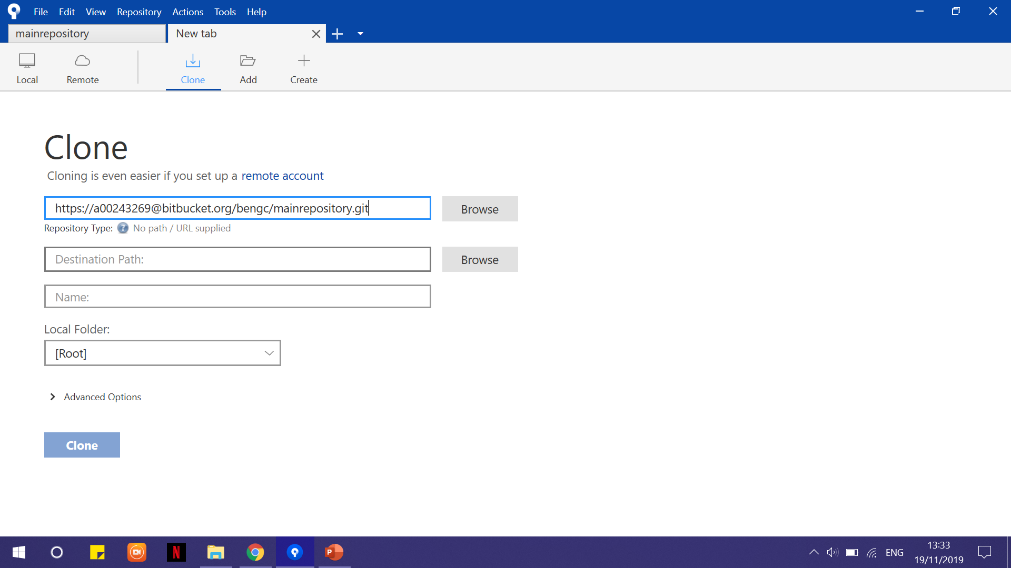
Implementation
First it is necessary to create the bitbucket team repository
All team members must be invited to the repository
Open SourceTree and clone the team repository and set the destination folder

Slide 6
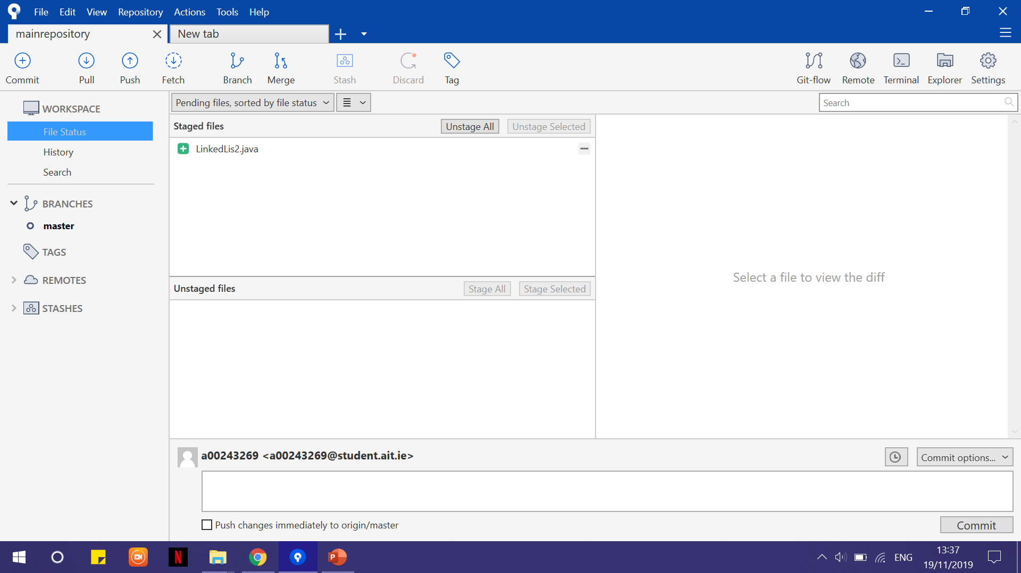
Implementation
In order to commit a file (linkedlis2), it must be added to the destination folder .
Then Stage the file
Commit the file with a comment and finally push the file.

Slide 7
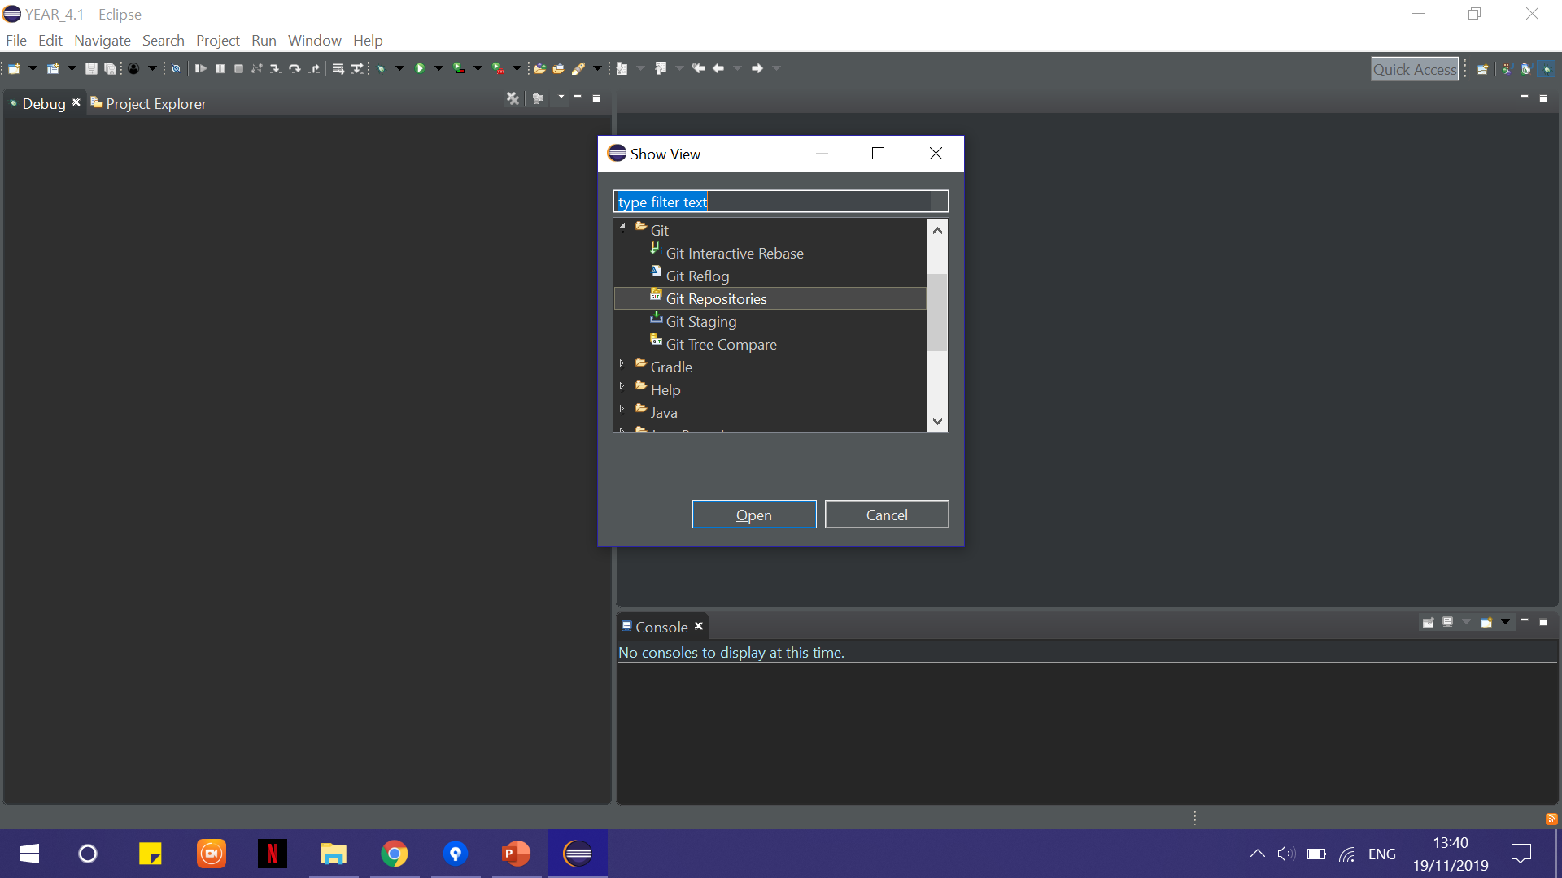
Implementation (java)
Create a Java project
Show git staging and git repositories
Connect repository with eclipse using the above features.
Share project with team repository in order to allow pushing, pulling and committing.

